Slide 1
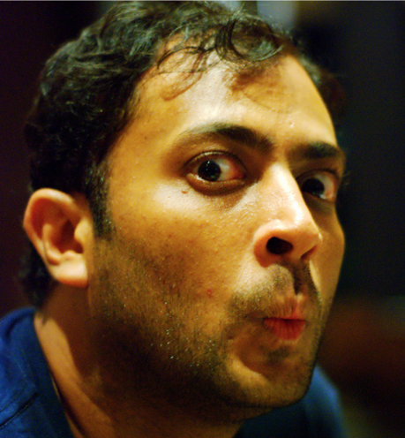


Philip Tellis
@bluesmoon
Nic Jansma
@nicj
https://github.com/SOASTA/boomerang
http://www.soasta.com/mpulse
https://github.com/SOASTA/measuring-continuity

Slide 2
Measuring Continuity
2016-06-22
#VelocityCONF 2016

Slide 3
boomerang
https://github.com/SOASTA/boomerang
WARNING: HUMANS WHO SUBMIT PULL REQUESTS ARE KNOWN TO HAVE BEEN HIRED

Slide 4
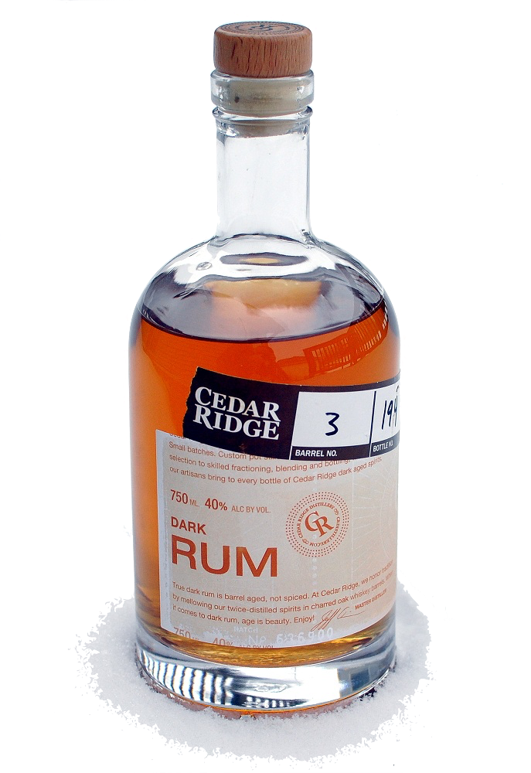
WHY
Notes:
Tells you real user experiences
Tells you how users react to those experiences
Gives you data fast enough to react or be proactive about fixing a bad experience

Slide 5
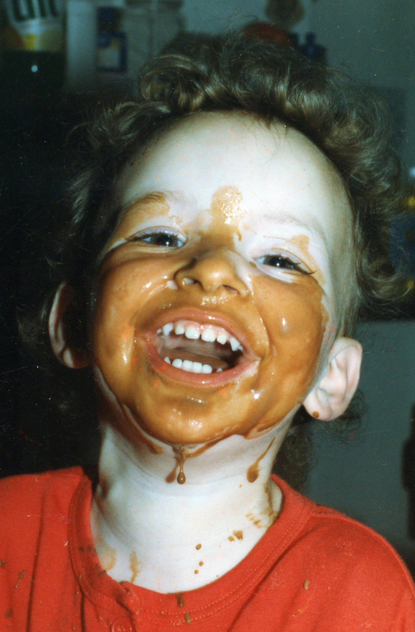
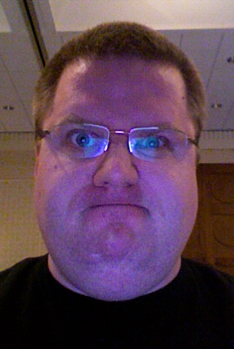
Delight
Or
Frustrate
Notes:
What does the user care about?
Was the experience delightful or frustrating?
How easy or hard was it to accomplish a task?
How smooth was the experience?
It’s up to us to figure out the details that contribute to delight and frustration
Eyebrow or smile/frown tracking maybe?

Slide 6

Delight
Responsiveness
Experience
Smoothness
Cognitive Dissonance/Resonance
Frustration
Notes:
What goes into an experience?
Responsiveness, ie, How quickly or slowly the browser reacts to a user action (click, scroll, etc.)
Smoothness, ie How smooth interacting with the browser is (animation, scrolling, typing)
Cognitive dissonance, ie, the user tried to do something but something else happened

Slide 7
RUM today
We measure everything up to navigation complete (page load or SPA nav)
We measure whether users bounce or convert
But
The bulk of user interaction and experience happens after navigation has completed
Notes:
Page Load Time, SPA load time
Waterfalls from RT
Static page structure, memory, network, etc.
User reaction in terms of bounce/conversion

Slide 8
Which continuous variables can we measure and how?

Slide 9
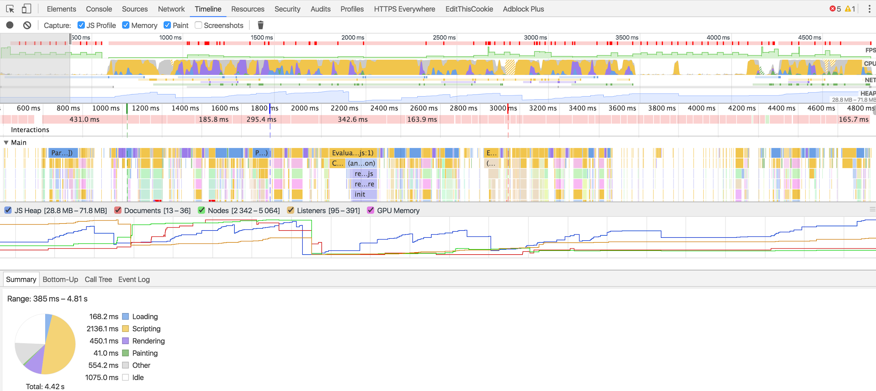
Developer Tools
Notes:
Let’s talk about how we can translate the data available in modern web browsers to the actual *experience* your visitors are getting after page load.
Everybody here probably has their favorite developer tools, right?
Here we see Chrome’s Developer Tools, which grow more and more powerful each year. As an application developer, we often want to try to collect “all the data” so we can get a sense of our visitor’s page load experiences. There is a treasure trove of information in dev tools. We use them to diagnose slow network activity, frame rates and JavaScript call stacks. The dev tools can be used for monitoring your app’s performance during development, but many of us would also like to collect similar data from our visitors in the wild too.
That’s what RUM is built around -- collecting performance metrics in aggregate to make decisions on how healthy your application is and alert when there are issues your customers are seeing.

Slide 10
Developer Tools
“The fact that something is possible to measure, and may even be highly desirable and useful to expose to developers, does not mean that it can be exposed as runtime JavaScript API in the browser, due to various privacy and security constraints”
— Performance APIs, Security and Privacy
https://w3c.github.io/perf-security-privacy/
Notes:
But we have to remember, there are tradeoffs to exposing the same level of details we get from dev tools have to JavaScript, where it could be captured by RUM. In fact, the W3C webperf WG has recently put out a note to address the ever-increasing pressure to try expose everything under the sun to JavaScript. [read quote].
It’s a very good article, and lays out a lot of the background privacy and security concerns for exposing more granular data than what we have today.

Slide 11
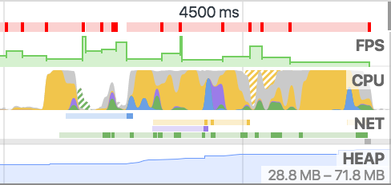
Continuity Metrics
Notes:
Here’s the good thing. One only has to start digging around the recent browser APIs to find a plethora of things you can measure about your visitor’s post-page-load experience. I’m going to show you can you can collect many of the same metrics that the Dev Tools expose today via JavaScript. They may not have the granularity you would expect to debug issues during development, but there’s plenty of information that can give you a sense of what you’re visitor’s experience is.
Let’s start out with the Dev Tools’ Timeline tab. The Timeline gives you an idea for how the app is performing over time, showing framerate, CPU usage, network activity and even memory data.
What can we gather today for RUM?

Slide 12
FPS - Frames Per Second
requestAnimationFrame(callback)
Callback is run before the next paint
1 // total frames seen this second
2 var frames = 0;
3
4 function measureFps() {
5 frames++;
6
7 // request a callback before the next frame
8 window.requestAnimationFrame(measureFps);
9 }
10
11 // start measuring
12 window.requestAnimationFrame(measureFps);
13
14 // report on frame rate (FPS) once a second
15 setInterval(function() {
16 console.log("FPS: " + frames);
17 frames = 0;
18 }, 1000);
Notes:
Let’s start with the first item - frames per second, or FPS. The optimal framerate on most devices today is around 60, which is most screen’s refresh rate. Anything less than that, and you’ll start seeing “Jank”, or stuttering. Staying at a consistent 60 FPS is essential for giving your visitors a smooth experience. Luckily, we can easily measure FPS. There’s a browser API, requestAnimationFrame, whose callback will be called by the browser immediately before the next repaint. We don’t need to do any actual work here, we can just count “frames” by how often the callback is run each second.

Slide 13
FPS - Long Frames
Frames > 16.6 ms lead to < 60 FPS
1 var lastFrame = performance.now();
2 var longFrames = 0;
3
4 function measureFps() {
5 var now = performance.now();
6
7 // calculate how long this frame took
8 if (now - lastFrame >= 18) { longFrames++; }
9
10 lastFrame = now;
11
12 window.requestAnimationFrame(measureFps);
13 }
14 window.requestAnimationFrame(measureFps);
15
16 // report on long frames once a second
17 setInterval(function() {
18 console.log("Long frames: " + longFrames);
19 longFrames = 0;
20 }, 1000);
Notes:
Similar to overall frame rate in a timeline, you may also want to track the number of “long frames” that your application saw. Each long frame is a stuttery user experience. These are represented in the Chrome Developer tools as the “red” periods above. Using performance.now() to get a high resolution timestamp, we can see how many milliseconds it was since the last frame. Anything more than 16.6 milliseconds will miss the 60 FPS target.

Slide 14
FPS - Video
HTML5 VIDEO metrics (Chrome/FF)
1 var latestFrame = 0;
2 var latestReportedFrame = 0;
3
4 setInterval(function() {
5 // find the first VIDEO element on the page
6 var vids = document.getElementsByTagName("video");
7 if (vids && vids.length) {
8 var vid = vids[0];
9 if (vid.webkitDecodedFrameCount || vid.mozPaintedFrames) {
10 latestFrame = vid.webkitDecodedFrameCount || vid.mozPaintedFrames;
11 }
12 }
13
14 console.log("Video FPS: "
15 + Math.max(latestFrame - latestReportedFrame, 0));
16
17 // reset count
18 latestReportedFrame = latestFrame;
19 }, 1000);
Notes:
If you’re presenting video to the visitor through the HTML5 VIDEO element, there are some (non-standard) browser APIs you can also use to capture the FPS of video. Video FPS is dependent on the network delivering new frames and the device’s video pipeline decoding them, so it may differ from the overall browser FPS.

Slide 15
CPU - Page Busy
Browser doesn’t expose CPU metrics directly
Detect Busy by running a function at a regular interval
See if the callback runs at the time we expect
If the callback was delayed, the page was Busy
Busy can be caused by other JavaScript, layout, render, etc
Notes:
So that gives us some good parity to Developer Tools for monitoring frame rate over time. What about the next item, CPU?
This is a case where the data available in the Developer Tools is far beyond what we can measure from JavaScript. Obviously we can’t get detailed trace or stack information from JavaScript, nor even overall browser CPU usage, primarily due to performance and privacy concerns.
However, we can still get a small sense of how busy the page is by doing our own “profiling”. For example, if we configure a callback to run on a regular interval (say every 25 milliseconds), we can see how often that callback hits its mark exactly. If it does not -- if it’s delayed -- we can presume that it was delayed because of other work the browser was doing. For example, other JavaScript was running, or the browser was working on layout, rendering or other tasks for the page.
Over time, over an interval, we can see how often these callbacks are delayed. If 20% of callbacks didn’t fire on time, we can make an educated guess that the page was busy around 20% of that interval.
We call this Page Busy.

Slide 16
CPU - Page Busy
11 setInterval(function() {
12 var now = performance.now();
13 var delta = now - last;
14 last = now;
15
16 // if we're more than 2x the poll
17 // + deviation, we missed one period completely
18 while (delta > ((POLLING_INTERVAL * 2)
19 + ALLOWED_DEVIATION_MS)) {
20 total++;
21 late++;
22 delta -= POLLING_INTERVAL; // adjust, try again
23 }
24
25 total++;
26
27 if (delta > (POLLING_INTERVAL + ALLOWED_DEVIATION_MS)) {
28 late++;
29 }
30 }, POLLING_INTERVAL);
Notes:
This certainly isn’t perfect, and we don’t get any detailed information about what was running or why we were delayed, but in testing this we’ve seen this metric correlate pretty heavily with what the Developer Tools report. And often, it matches the inverse of framerate.

Slide 17
NET - Resources
ResourceTiming
Bytes available in ResourceTiming2
1 var resources =
2 window.performance.getEntriesByType("resource");
3
4 // number of resources fetched
5 var resourceCount = resources.length;
6
7 // number of bytes
8 var bytesOverWire = 0;
9 resources.forEach(function(res) {
10 bytesOverWire +=
11 res.transferSize ? res.transferSize : 0;
12 });
13
14 console.log("Resources: " + resourceCount
15 + " " + bytesOverWire + "b");
Notes:
OK, so we’ve captured what we can from the CPU. Let’s take a look at what’s next, networking activity.
Luckily there’s already a lot of great information about the network exposed to JavaScript, primarily through the ResourceTiming interface. This interface reports on each resource fetched by the page. Doing some simple querying of the interface, and you can get rough stats like the number of resources fetched, and soon, content size and size over the wire.

Slide 18
HEAP - Memory Usage
Non-standard
Reduced precision to avoid privacy concerns
1 // report on JS object memory once a second
2 setInterval(function() {
3 var mem = window.performance
4 && window.performance.memory
5 && window.performance.memory.usedJSHeapSize;
6
7 console.log("Memory usage: " + mem);
8 }, 1000);
Notes:
OK, the final graph in the Developer Tools Timeline is the Heap graph. This graph is great for showing the memory consumption of the page over time. It can point out excessive usage by your page’s components, and even possibly leaks over time.
There’s no standard browser APIs for reporting memory usage, but Chrome has a few counters on the performance.memory object. For example, you can see the used and total JavaScript Heap size.

Slide 19
Battery
Monitor your visitor’s battery state
Reduce work on low battery
1 setInterval(function() {
2 navigator.getBattery().then(function(batt) {
3 console.log(batt.level);
4 });
5 }, 1000);
Notes:
Along the lines of other hardware metrics, you can also query the battery level from mobile devices.

Slide 20
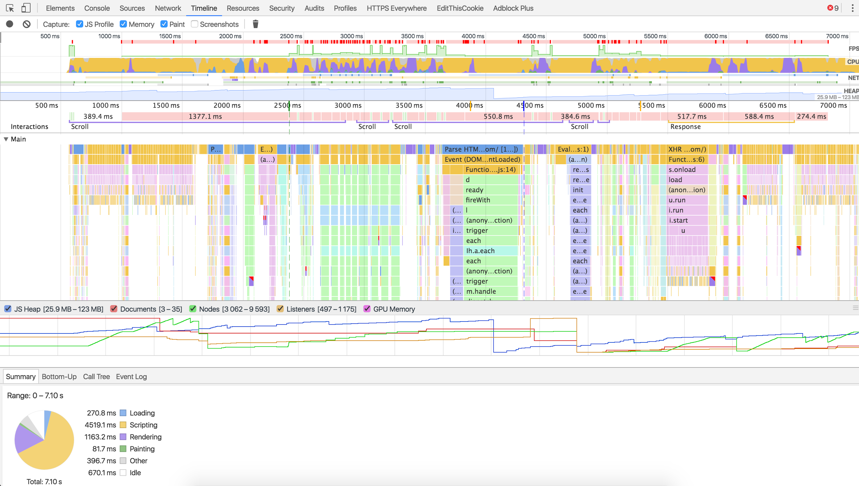
Interactions
Notes:
That covered the metrics-over-time graphs in the Timeline. What’s next?
Chrome also reports on User Interactions, and tracking these in your app is essential to annotating important events in your page’s lifecycle. Think of mouse movements and clicks, key presses and scroll events.
Keeping track of these user interactions is important because it will be useful later on to annotate important events in the app’s lifecycle. By monitoring what happens immediately after these user interactions, we can get a sense of how well your application performs in the face of change.

Slide 21
Interactions - User Input
scroll
mousemove
click
keydown
Notes:
Luckily monitoring for user interactions is really straightforward. For example, we can hook into the document’s “scroll” event and see how frequently, how far and how fast the user is scrolling around the page.
Similarly, you can hook into something like “keydown” and track the keys being pressed, etc.
Mouse movements and clicks are obviously the primary way your visitors interact with your site. We can listen for clicks, their target, and how often they’re happening to figure out how your visitor is behaving.
Similar to scroll events, we can monitor how quickly the mouse is moving, or how much of the screen it is covering.

Slide 22
Interactions - Visibility
Window’s visibility state
1 document.addEventListener("visibilitychange", function() {
2 console.log(document.hidden ? "hidden" : "visible");
3 }, false);
Also look at the IntersectionObserver
Notes:
Finally, it’s important to understand when the visitor is no longer interacting with your site. The Page Visibility API lets you determine if the document is “hidden”, and receive notifications when that state changes.

Slide 23
Interactions - Orientation
How the device is being held
1 window.addEventListener("orientationchange", function() {
2 console.log("orientation: " + screen.orientation.angle);
3 });
Notes:
From the hardware perspective, we can even determine some important state changes such as a transition from layout to portrait (or even frequent switching between the two).

Slide 24
Size Metrics
Notes:
That wraps up tracking what the user’s doing. What about the construction of the document? How does its’ complexity change over time?
The Chrome Developer Tools track heap, documents, nodes, listeners and GPU memory over time. We’ve already shown that we can track heap (with some browsers), what about the rest?

Slide 25
Size - Nodes
HTML size (bytes)
Overall Node count
IFRAME, IMG, SCRIPT, etc., node count
Notes:
Tracking the document’s complexity over time can give you insight why some of the other metrics are behaving. For example, as the size of the HTML document increases, it’s more likely you’ll be hitting issues with framerate or Page Busy as the browser spends more time parsing and laying out the document.
Using getElementsByTagName() you can track how many nodes there are in the DOM, or even get a breakdown of images, JavaScript, IFRAMEs, etc. Calculating the innerHTML length let’s you see how many bytes it takes to construct the root frame.

Slide 26
Size - DOM Changes
MutationObserver == change over time
1 var d = document;
2 var mutationCount = 0;
3 var domLength =
4 d.getElementsByTagName("*").length;
5
6 // create an observer instance
7 var observer = new MutationObserver(function(mutations) {
8 mutations.forEach(function(mutation) {
9 if (mutation.type !== "childList") { return; }
10 for (var i = 0; i < mutation.addedNodes.length; i++) {
11 var node = mutation.addedNodes[i];
12 mutationCount++;
13 mutationCount += node.getElementsByTagName ?
14 node.getElementsByTagName("*").length : 0;
15 }
16 });
17 });
18
19 // configure the observer
20 observer.observe(d, { childList: true, subtree: true });
Notes:
If you were to only track the number of nodes in the document, you may be missing other important periodic changes that are happening. Every DOM modification, insertion or deletion will cause the browser to do work. We can use a MutationObserver to get a lightweight notification of changes as they’re happening in real-time.
Counting the number of mutations as a percentage of the overall DOM node count can give you an indication into what percentage of the screen is changing on a periodic basis.

Slide 27
Errors
1 var errorCount = 0;
2
3 window.onerror = function () {
4 errorCount++;
5 }
6
7 setInterval(function() {
8 console.log("Errors: " + errorCount);
9 errorCount = 0;
10 }, 1000);
Notes:
Finally, it’s we can hook into the browser’s onerror event to monitor for JavaScript errors as they happen in real-time.
Obviously every JavaScript error is an opportunity to break your user’s experience, so you may want to track and trend on these over time, especially after your users have interacted with your site.
Similarly, you can monitor the networking stack for request errors and report on these.
Error tracking and alerting is a huge topic on its own, but is an important part of measuring the user’s overall experience.

Slide 28
Demo
https://github.com/SOASTA/measuring-continuity
Notes:
To prove all of these metrics work, we’ve built a GreaseMonkey script that shows a realtime timeline of FPS, Page Busy, Interactions, DOM sizes, etc over time, and graphs them with Rishaw. You can get it at the Github repo listed.

Slide 29
So what?
Raw data != useful metrics
Let’s measure the user experience
Smoothness
Responsiveness
Reliability
Emotion
Notes:
OK, so we just went over a bunch of metrics that we can gather over time to monitor how your application is behaving. So what? Most of these metrics aren’t necessarily interesting on their own. For example, your user clicked something! And then scrolled! Hooray!
Obviously, gathering these types of metrics on their own can be helpful in tracking a user experience, but they’re not the only story.
How can we combine these metrics to tell a better story of how your user enjoyed -- or hated -- your site?
How smooth was your page? How responsive?
How reliable was it?
What was your visitor feeling?

Slide 30

Smoothness - FPS during scroll
FPS during page load
Notes:
Let’s start with framerate. On it’s own, it’s just a number. 60 FPS.
Over time, it tells a story. What was the framerate during the page load? What was the framerate while the user was scrolling? What was the framerate immediately after a user action like a button click? All of these are critical events in your visitor’s experience, and the framerate is one indicator to how smooth of an experience they’re having.
For any site that has content below the fold, the scrolling experience is where your site can shine, or, leave a bad impression with your visitors.
Simon Hearne built a wonderful bookmarklet that will use rAF to monitor the FPS while it forcefully scrolls your screen. It monitors the FPS until it hits the scroll bottom, and reports on the FPS over time.
As one example, this site drops below 60 FPS several times during scrolling. You can feel it. The site fees sluggish and jittery. Towards the end of the page it starts to reach 60 FPS but there are still a few periods that drop it to ~10 FPS because of a periodic timer that modifies the DOM.

Slide 31
Smoothness - FPS after interaction
Notes:
Besides scrolling, the user is probably interacting with your site in many ways through clicking, scrolling and moving the mouse around. It’s important to monitor FPS immediately after these interactions. These are guaranteed points the user is paying attention to what’s going on, and you want to provide the best experience during these periods.

Slide 32
Responsiveness
How long it takes for the site to respond to input?
requestAnimationFrame to detect next paint
MutationObserver to detect DOM changes
UserTiming to monitor your own code
SPA instrumentation via boomerang
Notes:
Besides how smooth the experience is, what about how good your site responds to user input?
After we’ve detected a click, key or scroll, what happens next to the site? How long does it take for the site’s content to change so that the user is sufficiently confident their action resulted in the site responding?
You may have already instrumented your own code using something like UserTiming. UserTiming gives you a convenient way to measure important events in your page’s lifecycle.
We could also use something like MutationObserver to detect how long it took the DOM to change after the user’s interaction.

Slide 33
Responsiveness
1 document.addEventListener("click", function(e) {
2 var start = performance.now();
3 requestAnimationFrame(function() {
4 var delta = performance.now() - start;
5 console.log("Click responsiveness: " + delta);
6 });
7 }, false);

Slide 34
Reliability
JavaScript errors
Leaks:
JavaScript memory usage over time
DOM size increase over time
Notes:
Finally, it’s critical to ensure your site doesn’t have any reliability issues as the user is interacting with it.
Obviously, tracking JavaScript errors is a core way of monitoring your site’s reliability. But with the other metrics we’re tracking like DOM size and memory usage over time, we can monitor for leaks in your site’s code. Small leaks may not immediately affect a new visitor’s experience, but as cheap mobile devices proliferate throughout the world, we want to make sure we’re as efficient as possible.

Slide 35
Tracking Emotion
Notes:
But again -- how do all of these metrics communicate how your user feels?
What are they going to take away from their experience on your site? Will they come back? Were they satisfied or angry?
What if we could track emotion?
Today, along with new technology specially developed by the NSA, we’re proud to announce the new Emotion Tracking API… just kidding.

Slide 36
Rage Clicks
Rage clicks are series of clicks in which your users are pummeling their mouse buttons in frustration. It’s like punching your site in the face, usually because it’s not doing what the user wants or expects it to.
— Caitlin Brett, FullStory
https://blog.fullstory.com/moar-magic-announcing-rage-error-and-dead-clicks-1f19e50a1421
Notes:
Let’s start out with something simple. How can you detect that your visitor isn’t getting the interaction they expect out of your site?
Take clicking on a button as an example. Most people expect some sort of visual feedback that the button was clicked. A “pressed” indicator, or, some other sort of visual feedback.
But what if something is broken, and the button isn’t working? Most people’s first reaction is to wait a little bit, and try again -- thinking they were the issue.
By simply tracking where and how quickly the mouse is being clicked, especially on the same element, you might not only get reports of where your site is broken, but even where your site just isn’t working as the user expects.

Slide 37
Rage Clicks
1 var same = 0, x = 0, y = 0, targ = null;
2
3 document.addEventListener("click", function(e) {
4 var nX = e.clientX; var nY = e.clientY;
5
6 // calculate number of pixels moved
7 var pixels = Math.round(
8 Math.sqrt(Math.pow(y - nY, 2) +
9 Math.pow(x - nX, 2)));
10
11 if (targ == e.target || pixels <= 10) {
12 same++;
13 } else {
14 same = 0;
15 }
16
17 console.log("Same area clicked: " + same);
18
19 x = nX; y = nY; targ = e.target;
20 }, false);
Notes:
This code is 20 lines long, has debateable coding style, and lots of colours… IOW, it’s easy.

Slide 38
Dead Clicks
Clicking without any meaningful visual (DOM) change
Might happen during (or right after) page load due to delayed JavaScript
Notes:
Similar to rage clicks, what about dead clicks -- clicks on a non-interactive element on your site.
Maybe you have something that looks like a link, but isn’t? Maybe your design is missing a key convention that users expect?
Dead clicks can help you detect when a click didn’t result in any meaningful change.
One easy way to detect Dead Clicks is by listening to the clicks and then network activity and Mutations. If neither a network request nor a DOM change happened, it’s possible that you’ll want to investigate exactly what the user’s clicking.
Now not all clicks are from people wanting to interact with your site. Some people click for no reason, because they’re click-happy, or may even read the page by highlighting text.

Slide 39
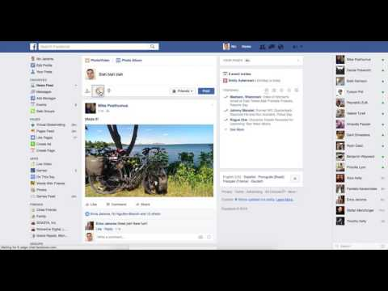
Dead Clicks
Notes:
Similar to rage clicks, what about dead clicks -- clicks on a non-interactive element on your site.
Maybe you have something that looks like a link, but isn’t? Maybe your design is missing a key convention that users expect?
Dead clicks can help you detect when a click didn’t result in any meaningful change.
One easy way to detect Dead Clicks is by listening to the clicks and then network activity and Mutations. If neither a network request nor a DOM change happened, it’s possible that you’ll want to investigate exactly what the user’s clicking.
Now not all clicks are from people wanting to interact with your site. Some people click for no reason, because they’re click-happy, or may even read the page by highlighting text.

Slide 40
Missed Clicks
User clicks near an element, but misses it
Notes:
This happens when click targets are hard to hit

Slide 41
Mouse Movement
“People who are angry are more likely to use the mouse in a jerky and sudden, but surprisingly slow fashion.
People who feel frustrated, confused or sad are less precise in their mouse movements and move it at different speeds.”
— Inferring Negative Emotion from Mouse Cursor Movements
Martin Hibbeln, Jeffrey L. Jenkins, Christoph Schneider, Joseph S. Valacich, and Markus Weinmann
Notes:
There’s been a study by BYU researchers on mouse movements. [read above]

Slide 42
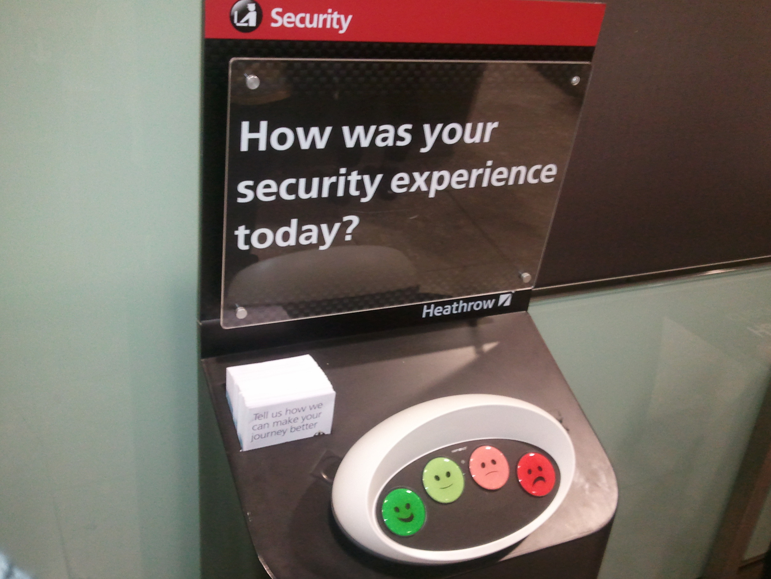
Ask Directly
Notes:
Finally, there’s something to be said for just asking your users directly how they feel.
I don’t know how many of you fly through MSP, but at the Rock Bottom there, there’s this stand facing customers as they leave, asking how their experience was. Here’s a picture of a similar stand for a security checkpoint at Heathrow.

Slide 43

Rage Clicking
Notes:
Now in researching the company that makes these booths, Happy Or Not, I was presented with the popup in this screenshot.
Any time I see a modal popup or something like this, my immediate gut reaction is to hit the Escape key as fast as I can so I can get back to whatever I was doing. In this case, when I hit Escape, nothing happened. So I slammed the Escape key a few more times, hoping the site would get the hint that I wasn’t happy to be bothered by this popup. Only clicking on the small X got me out of the dialog.
This is another example of Dead and then Rage Clicking, in a way. I immediately hit Escape because I expected the popup to disappear, as many sites (and a long tradition of window interfaces) respect. When that didn’t work right away, I hit Escape a few more times for good measure.
Don’t make me find your silly little tiny X if I can quickly hit the Escape key like convention dictates.

Slide 44
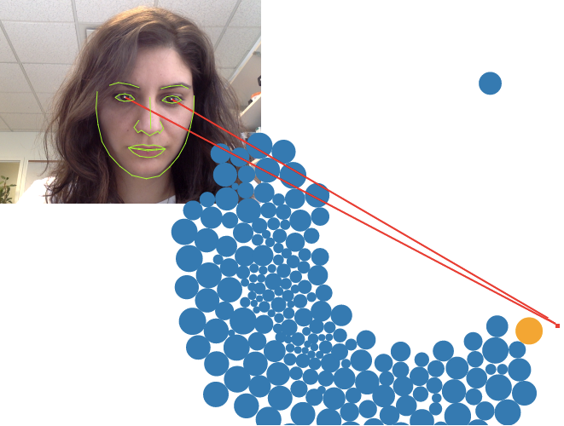
Eye Tracking
https://webgazer.cs.brown.edu/
Notes:
Finally, there’s some interesting things people are doing with video cameras these days. There’s a project called webgazer, which uses your laptop’s video camera and does real-time eye tracking to see where on the screen you’re looking.
Obviously this has multitudes of privacy implications, but it’s an example of monitoring your user’s interaction with your site.

Slide 45
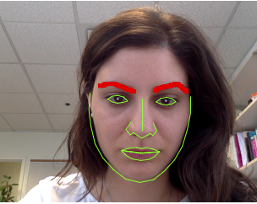
Eyebrow Tracking
https://webgazer.cs.brown.edu/
Notes:
But what if we could look at eyebrows instead, and other facial features?

Slide 46
Emotion - α / β wave Tracking
Mind Reading Markup Language
Notes:
Or tap directly into the user’s brainwaves

Slide 47
Further Reading
Rage Clicks http://blog.fullstory.com/2015/12/reducing-ux-rage-with-fullstorys-rage-clicks/
Inferring Emotion from Mouse Movements http://www.telegraph.co.uk/technology/news/12050481/Websites-could-read-emotions-by-seeing-how-fast-you-move-your-mouse.html
Scroll Behaviour http://blog.chartbeat.com/2013/08/12/scroll-behavior-across-the-web/
WebGazer: Eye tracking in JavaScript http://webgazer.cs.brown.edu/
What JavaScript knows about you http://webkay.robinlinus.com/
Prerender Events https://wiki.whatwg.org/wiki/Link_prerender_events
RequestAnimationFrame https://developer.mozilla.org/en-US/docs/Web/API/window/requestAnimationFrame
RequestIdleCallback https://developers.google.com/web/updates/2015/08/using-requestidlecallback IntersectionObserver https://wicg.github.io/IntersectionObserver/
Video Metrics https://wiki.whatwg.org/wiki/Video_Metrics
Resource Timing https://www.w3.org/TR/resource-timing/
The Runtime Performance Checklist http://calendar.perfplanet.com/2013/the-runtime-performance-checklist/
Jank Meter https://webperf.ninja/2015/jank-meter/
RAIL Performance Audit of SFGate.com https://docs.google.com/document/d/1K-mKOqiUiSjgZTEscBLjtjd6E67oiK8H2ztOiq5tigk
Performance: Security & Privacy Considerations https://w3c.github.io/perf-security-privacy/
Motion Mark Analysis https://docs.google.com/document/d/1vKNGim07lvPCYL1ctiNss1BqhjfE49t6LwZkwoTkeXU/mobilebasic
Debouncing and Throttling Events https://css-tricks.com/debouncing-throttling-explained-examples/
Code Examples from this talk https://github.com/SOASTA/measuring-continuity

Slide 48
Thank You

Slide 49
Photo Credits
Rum on Ice by wiserbailey https://www.flickr.com/photos/25084516@N03/4317148060/
Angel Delight by Auntie P https://www.flickr.com/photos/auntiep/360764980/
Frustrated by Kevin Lawver https://www.flickr.com/photos/kplawver/1903240219/

Slide 50
Philip Tellis
@bluesmoon
Nic Jansma
@nicj
https://github.com/SOASTA/boomerang
http://www.soasta.com/mpulse
https://github.com/SOASTA/measuring-continuity

